Slide 1
Jeopardy
Java Math
If statements
Arrays & ArrayLists
Recursion
Inheritance
$100
$100
$100
$100
$100
$200
$200
$200
$200
$200
$300
$300
$300
$300
$300
$400
$400
$400
$400
$400
$500
$500
$500
$500
$500
Final Jeopardy

Slide 2
1 - $100
12.8 * 17.5 – 34.5
189.5

Slide 3
1 - $200
int a = 7;
int b = 2 + (a++);
System.out.print(b+a);
17

Slide 4
1 - $300
4 * 3 + 7 / 5 - 25/5
8

Slide 5
1 - $400
3 ^ 5
Does not compute

Slide 6
1 - $500
int a = 5;
int b = (a++) + 3;
int c = 2 * a + (++b);
b = 2 * (++c) – (a++);
System.out.print(a+” ”+b+” ”+c);

Slide 7
2 - $100
What are nested if statements?
If inside of an if

Slide 8
2 - $200
int score =99;
if (++score == 100) { grade = ’A’; System.out.println("Superb"); }
else if (score >= 90) { grade = ’A’; System.out.println("Excellent"); } else if (score >= 80) { grade = ’B’; System.out.println("Very Good"); } else if (score >= 70) { grade = ’C’; System.out.println("Good"); }
else if (score >= 60) grade = ’D’; else grade = ’F’

Slide 9
2 - $300
Write an if statement that if integer variable currentNumber is odd, change its value so that it is now 3 times currentNumber plus 1, otherwise change its value so that it is now half of currentNumber
Check

Slide 10
2 - $400
if x is 4 :
  print (‘x is 4’)
  Name all the errors with this code
if(x==4)
  {
  System.out.print(“x is 4”);
  }

Slide 11
2 - $500
String s = “house”;
String s1 = “house”;
if(s==s1)
System.out.print(“Equal”);
else
System.out.print(“Not equal”);
Not equal

Slide 12
3 - $100
Name 2 differences between Arrays and ArrayLists
ArrayLists can only hold objects, ArrayLists uses wrappers, Arrays use [][], ArrayLists have methods, Arrays are 1D or 2D, etc.

Slide 13
3 - $200
Can we change size of an array or an ArrayList after initialization?
In an array, size is set.
  But not in an ArrayList.

Slide 14
3 - $300
Create an ArrayList nums with type Integer and add numbers 1-10.
Check

Slide 15
3 - $400
Are ArrayLists passed by reference or by value? Arrays?
Both are passes by reference to methods because they are both objects. This means that the original value is changed if they are changed in the method.

Slide 16
3 - $500
Create a 1D array of chars and put in values to create sentence “Java is cool”. (with one line of code)
Check

Slide 17
4 - $100
public void mystery2(int nNum)
{ if(nNum <= 0)
return;
System.out.println(nNum);
mystery2(nNum - 1);
}
mystery2(5)
5/4/3/2/1

Slide 18
4 - $200
public void wow (int n)
{ if (n > 1)
wow (n / 3);
else
System.out.print(n + “ “); }
wow(50)
1

Slide 19
4 - $300
public int mystery(int n)
{ if (n < 0)
return 2;
else
return mystery(n-1)+mystery(n-3);}
What value is returned by the method call mystery(3) ?
12

Slide 20
4 - $400
Write a recursive method that returns the factorial of a given number.
Check

Slide 21
4 - $500
Write the summation of numbers from a given start to a given end in recursive form
Check

Slide 22
5 - $100
Name all relationships in inheritance and how they are related.
Check

Slide 23
5 - $200
Name 1 benefit of inheritance
Code reusability, Mehod overriding etc

Slide 24
5 - $300
Make an inheritance diagram with at least 7 shapes. It must have at least one descendant
Check

Slide 25
5 - $400
How do you override your parent’s method
Write the same exact method header but with different code inside.

Slide 26
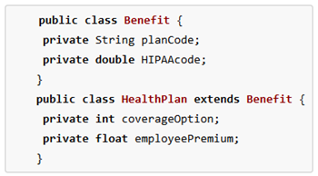
5 - $500
coverageOption and employeePremium can’t be used in Benefit

Slide 27
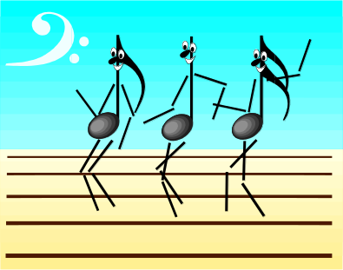
Final Jeopardy
Write a class named hitman that stores his x pos, his y pos, the amount of bullets left, and wether his target is dead or not. Write accessors and mutators. Write a constructor that sets all of these attributes.
Type answer to appear with a mouse-click here

